Slide 1

MACHINE LEARNING PROJECT · PRECISION AGRICULTURE
Smart Crop Recommendation and Farm Advisory System Using Machine Learning
Soil + climate data → Random Forest model → best crop & fertilizer advice
PRESENTED BY
UNDER THE GUIDANCE OF
Lahari Namala
Roll No: 2520090226
K. Keathana Vikashini
Roll No: 2520090236
Haritha
Assistant Professor, Dept. of CSIT
99.55%
Random Forest accuracy
Department of Computer Science and Information Technology (CSIT) · KL University, Hyderabad · A.Y. 2026–27
Notes:
Good morning everyone. Our project is titled Smart Crop Recommendation and Farm Advisory System Using Machine Learning. It belongs to the area of precision agriculture. In simple words, a farmer enters soil and weather values, and our machine learning model tells which crop is best for that land, along with fertilizer advice. Our best model, Random Forest, gave 99.55 percent accuracy. This project was done by Lahari Namala and K. Keathana Vikashini of the Department of CSIT, under the guidance of Haritha madam, Assistant Professor, Department of CSIT. I will now explain the project step by step.

Slide 2






Introduction
Crop recommendation
Suggests the most suitable crop for a field from its soil nutrients and local climate.
Soil + climate values
Precision agriculture
ML model
Uses measured data to make field-level decisions instead of guesswork.
Why machine learning?
Best crop + advice
Learns patterns from 2,200 past records and gives fast, consistent advice to every farmer.
Notes:
Crop recommendation means suggesting the right crop for a piece of land. The right crop depends on soil nutrients like nitrogen, phosphorus and potassium, and on climate factors like temperature, humidity and rainfall. Precision agriculture is the idea of using actual measured data to make farming decisions for each field. Machine learning fits here because it can study thousands of past examples and learn which conditions suit which crop. Once trained, it gives a quick and consistent answer for any farmer. The box on the right shows the basic idea: values go in, the model processes them, and the best crop comes out.

Slide 3






Problem Statement
Farmers often choose crops by habit or guesswork, even though soil, rainfall, nutrients and climate change from field to field and season to season.
Soil nutrients
Rainfall
Climate
Soil pH
N, P, K levels differ
Uneven every season
Temp & humidity shift
Acidic to alkaline
Wrong crop choice
Low yield, wasted fertilizer, money loss
Who is affected?
Small farmers with no access to soil experts
Notes:
The main problem is that choosing the right crop is hard. Farmers usually decide based on what they grew last year or what neighbours are growing. But the four factors shown here, soil nutrients, rainfall, climate and soil pH, are different for every field and keep changing. If the crop does not match the conditions, the yield drops, fertilizer is wasted and the farmer loses money. The people most affected are small and marginal farmers who cannot easily consult a soil expert or agriculture officer.

Slide 4




Motivation
Real-world need
Better yield
Most small farmers cannot easily reach soil scientists or agronomists for advice.
Matching the crop to soil and climate improves the chance of a healthy harvest.
Less fertilizer waste
Data-driven farming
Nutrient-based advice avoids overusing urea, DAP and potash.
Decisions backed by measured values, and ML is cheap to run on any device.
Notes:
We chose this project because it solves a real problem. Many farmers do not have easy access to experts. If we recommend the right crop, the yield can improve. Fertilizer advice based on actual nutrient values helps farmers avoid using too much urea, DAP or potash, which saves money and protects the soil. Finally, we wanted to show how data and machine learning can make farming decisions smarter, and a trained model is very cheap to run.

Slide 5

Objectives
MAIN OBJECTIVE
Build a web system that recommends the best crop and a fertilizer plan from soil and climate values using machine learning.
1
Collect and preprocess the Crop Recommendation dataset (2,200 records, 22 crops)
2
Train and compare five ML classifiers and select the best one
3
Show the top 3 suitable crops with confidence scores
4
Give simple fertilizer advice based on N, P, K and soil pH
5
Deploy the model in a Flask web app with dashboard, updates and history
Notes:
Our main objective is to build a website that recommends the best crop and gives fertilizer advice using machine learning. To reach this, we set five specific objectives. First, collect and clean the dataset. Second, train five different algorithms and pick the best one. Third, show not just one crop but the top three, with confidence scores. Fourth, give fertilizer advice using nitrogen, phosphorus, potassium and pH values. Fifth, put everything into a Flask web application that a farmer can use easily.

Slide 6



Existing System
How crops are chosen today
Limitations
Manual selection
Repeat last season's crop or follow neighbours
Subjective and inconsistent
Ignores measured soil and weather data
Experts are hard to reach in villages
No nutrient-based fertilizer guidance
Slow to adapt to changing climate
Farmer experience
Knowledge passed down, not measured data
Local expert advice
Agri officer or dealer, not always available
Notes:
In the existing system, crop selection is mostly manual. Farmers repeat what they grew before, depend on experience handed down in the family, or ask a local agriculture officer or fertilizer dealer. These methods have clear limitations. They are subjective, so two people may give different advice. They do not use actual soil test or weather data. Experts are not always available in rural areas. There is no proper fertilizer guidance based on nutrients, and these methods do not adapt quickly when climate patterns change.

Slide 7





Proposed System
Smart Crop AI is a farmer-friendly website. The farmer enters 7 soil and weather values and instantly gets an ML-based crop recommendation with fertilizer advice.
Crop prediction
Top 3 crops
How it fixes the gaps
Guesswork
ML prediction from data
Fertilizer advice
Weather updates
No expert nearby
Advice online, anytime
No fertilizer plan
N-P-K and pH based tips
Market updates
Prediction history
Notes:
Our proposed system is the Smart Crop AI website. The farmer simply enters seven values: nitrogen, phosphorus, potassium, temperature, humidity, pH and rainfall. The machine learning model then predicts the best crop. On the left you can see how it fixes the problems of the existing system: guesswork is replaced by data-based prediction, advice is available online at any time, and fertilizer tips are based on the actual nutrient values. On the right are the six main features: crop prediction, top three crops, fertilizer advice, weather updates, market updates and prediction history.

Slide 8





System Architecture
User Login
Enter Farm Values
Flask Backend
ML Model
Crop Result
Fertilizer Advice
Dashboard
Presentation layer
Application layer
ML layer
HTML, CSS, JavaScript: login, input form, result and dashboard screens
Flask REST API: POST /api/predict validates the 7 inputs and calls the model
Random Forest (200 trees) loaded from crop_model.joblib returns top 3 crops + fertilizer plan
Notes:
This is the architecture of our system. Follow the boxes from left to right. The user first logs in, then enters the farm values in a form. These values are sent to the Flask backend. Flask passes them to the trained machine learning model. The model predicts the crop, and our code compares the soil values with the crop's needs to give fertilizer advice. Finally, everything is shown on the dashboard. The colours show three layers: the light boxes are the frontend made with HTML, CSS and JavaScript; the medium green box is the Flask application layer; and the dark boxes are the machine learning layer, where the Random Forest model saved as a joblib file does the prediction.

Slide 9






Methodology / Workflow
STEP 1
STEP 2
STEP 3
STEP 4
STEP 5
STEP 6
STEP 7
Dataset collection
Preprocessing
Model training
Evaluation
Save model
Flask deployment
UI display
Crop Recommendation CSV, 2,200 rows
Check nulls and duplicates, scale features
5 algorithms, 80/20 stratified split
Accuracy, precision, recall, F1
Best model saved with Joblib
REST endpoint /api/predict
Crop, top 3, fertilizer, history
Training: Google Colab Web app: VS Code + Flask Selection rule: highest macro F1-score
Notes:
This slide shows our step-by-step workflow. Step one, we collected the Crop Recommendation dataset with 2,200 rows. Step two, we preprocessed it: we checked for missing values and duplicates, and scaled the features for algorithms that need it. Step three, we trained five algorithms using an 80 to 20 train-test split, keeping the crop proportions equal. Step four, we evaluated each model using accuracy, precision, recall and F1-score. Step five, we saved the best model using Joblib. Step six, we connected the model to a Flask API. Step seven, the result is shown on the website. We trained in Google Colab and built the web app in VS Code. The model with the highest macro F1-score was automatically selected.

Slide 10






Technology Stack
Frontend
Backend
ML libraries
HTML5, CSS3, JavaScript
Python, Flask 3.0
Pandas, NumPy, Scikit-learn, Joblib
Dataset
Tools
IDE
Crop Recommendation CSV (2,200 rows)
Google Colab, Matplotlib, Seaborn
Visual Studio Code, Chrome browser
Notes:
Here is our technology stack. The frontend is built with HTML, CSS and JavaScript. The backend uses Python with the Flask framework. For machine learning we used Pandas to load data, NumPy for numbers, Scikit-learn to train the models and Joblib to save the trained model. The dataset is the Crop Recommendation CSV file. We used Google Colab for training and Matplotlib and Seaborn for graphs. For coding the website we used Visual Studio Code and tested it in Chrome.

Slide 11



System Modules
Login module
Crop recommendation
Farmer signs in before using the dashboard
Takes 7 inputs, returns best crop and top 3
Fertilizer advice
Update module
Compares N, P, K and pH with crop needs
Weather and market price updates
History module
Profile module
Saves past predictions to review later
Farmer details, location and land area
Notes:
Our system has six modules. The login module lets the farmer sign in. The crop recommendation module is the heart of the project: it takes seven inputs and returns the best crop along with the top three choices. The fertilizer advice module compares the farmer's nitrogen, phosphorus, potassium and pH values with what the crop needs and suggests corrections. The update module shows weather and market price updates. The history module keeps a list of past predictions. The profile module stores the farmer's details like location and land area.

Slide 12
Dataset / Input Data
Feature | Meaning | Unit
N | Nitrogen in soil | ratio
P | Phosphorus in soil | ratio
K | Potassium in soil | ratio
temperature | Air temperature | °C
humidity | Relative humidity | %
ph | Soil pH value | 0–14
rainfall | Rainfall | mm
2,200
22
Records
Crop classes
7
100
Input features
Rows per crop
Target: label (crop name, e.g. rice, maize, cotton, coffee)
Preprocessing
0 missing values
0 duplicates
StandardScaler (LR, SVM, KNN)
80/20 stratified split
Notes:
We used the Crop Recommendation dataset. It has 2,200 records and 22 crop classes like rice, maize, cotton and coffee. Every crop has exactly 100 rows, so the dataset is perfectly balanced. Each record has seven input features: nitrogen, phosphorus and potassium in the soil, temperature, humidity, soil pH and rainfall. The output, called label, is the crop name. For preprocessing, we confirmed there are no missing values and no duplicates. We scaled the features using StandardScaler for Logistic Regression, SVM and KNN, because these algorithms are sensitive to the size of numbers. Then we split the data 80 percent for training and 20 percent for testing, keeping all crops equally represented.

Slide 13





Algorithms / Models
Model | Simple idea | Setting
Multinomial Logistic Regression | Draws linear boundaries and gives a probability for each of the 22 crops | lbfgs, C = 1.0
Random Forest | Many decision trees vote; the majority wins, which reduces overfitting | 200 trees
Support Vector Machine | Finds the widest gap between crops using a curved (RBF) boundary | RBF kernel
K-Nearest Neighbors | Looks at the 5 most similar farms in the data and takes their crop | k = 5
Decision Tree | Asks yes/no questions like "rainfall > 150 mm?" to reach a crop | single tree
Notes:
We tried five algorithms. Multinomial Logistic Regression draws straight-line boundaries and gives a probability for each crop. Random Forest builds 200 decision trees and lets them vote, which makes it very accurate and less likely to overfit; that is why it is highlighted. Support Vector Machine finds the widest possible gap between crop groups using a curved boundary. K-Nearest Neighbors looks at the five most similar records and picks their crop. Decision Tree asks a series of yes or no questions, like is rainfall more than 150 millimetres, until it reaches a crop. Logistic Regression, SVM and KNN used scaled inputs.

Slide 14
Model Evaluation
Model | Acc | Prec | Rec | F1
Random Forest | 99.55 | 99.57 | 99.55 | 99.55
SVM (RBF) | 98.41 | 98.56 | 98.41 | 98.40
KNN | 97.95 | 98.04 | 97.95 | 97.93
Decision Tree | 97.95 | 98.06 | 97.95 | 97.94
Logistic Reg. | 97.27 | 97.40 | 97.27 | 97.25
All values in %. Precision, recall and F1 are macro-averaged over 22 crops on 440 unseen test records (20% hold-out).
Axis starts at 90% to show the differences
Notes:
To compare the models, we tested each one on 440 records that the model had never seen during training. The chart shows accuracy, and the table shows accuracy, precision, recall and F1-score. Precision tells us how many predicted crops were correct. Recall tells us how many actual crops were found. F1-score is the balance of both. Random Forest is the clear winner with 99.55 percent accuracy and 99.55 percent F1-score. SVM is second at 98.41 percent. All five models performed well because the dataset is clean and balanced, but Random Forest was the most reliable. Note that the chart axis starts at 90 percent so the differences are visible.

Slide 15
Results
Sample prediction
BEST MODEL
Random Forest
N 80
P 45
K 40
Temp 24 °C
Humidity 80%
pH 6.5
Rainfall 170 mm
99.55%
Top 3 crops (model confidence)
Jute
94.0%
test accuracy · 438 of 440 correct
Rice
5.5%
99.57
99.55
99.55
Watermelon
0.5%
Precision
Recall
F1-score
Fertilizer: N, P, K levels are good; pH 6.5 is suitable. Use organic manure, avoid over-fertilizing.
Notes:
This slide shows our final result. Random Forest is our best model with 99.55 percent accuracy. Out of 440 test records, it predicted 438 correctly. The only two mistakes were one blackgram predicted as maize and one rice predicted as jute, which are crops with similar conditions. Precision, recall and F1-score are all about 99.5 percent. On the right is a sample prediction from our trained model. For nitrogen 80, phosphorus 45, potassium 40, temperature 24 degrees, humidity 80 percent, pH 6.5 and rainfall 170 millimetres, the model recommends jute with 94 percent confidence, followed by rice and watermelon. The fertilizer module checks that the nutrient levels are fine and suggests using organic manure and avoiding over-fertilizing.

Slide 16
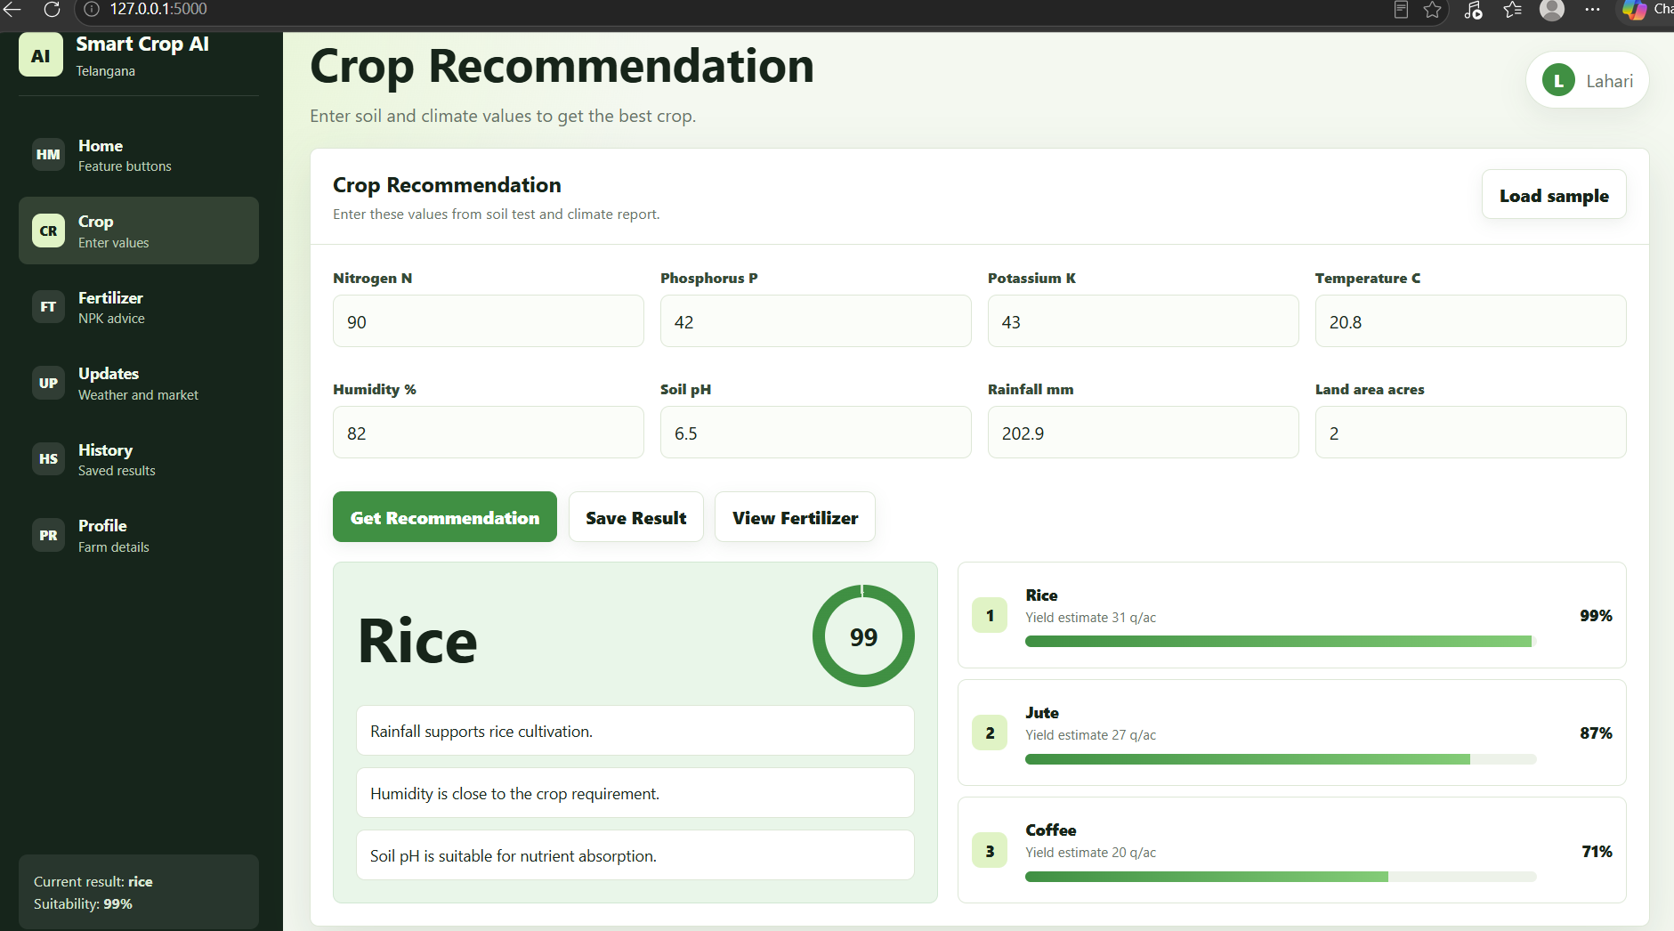
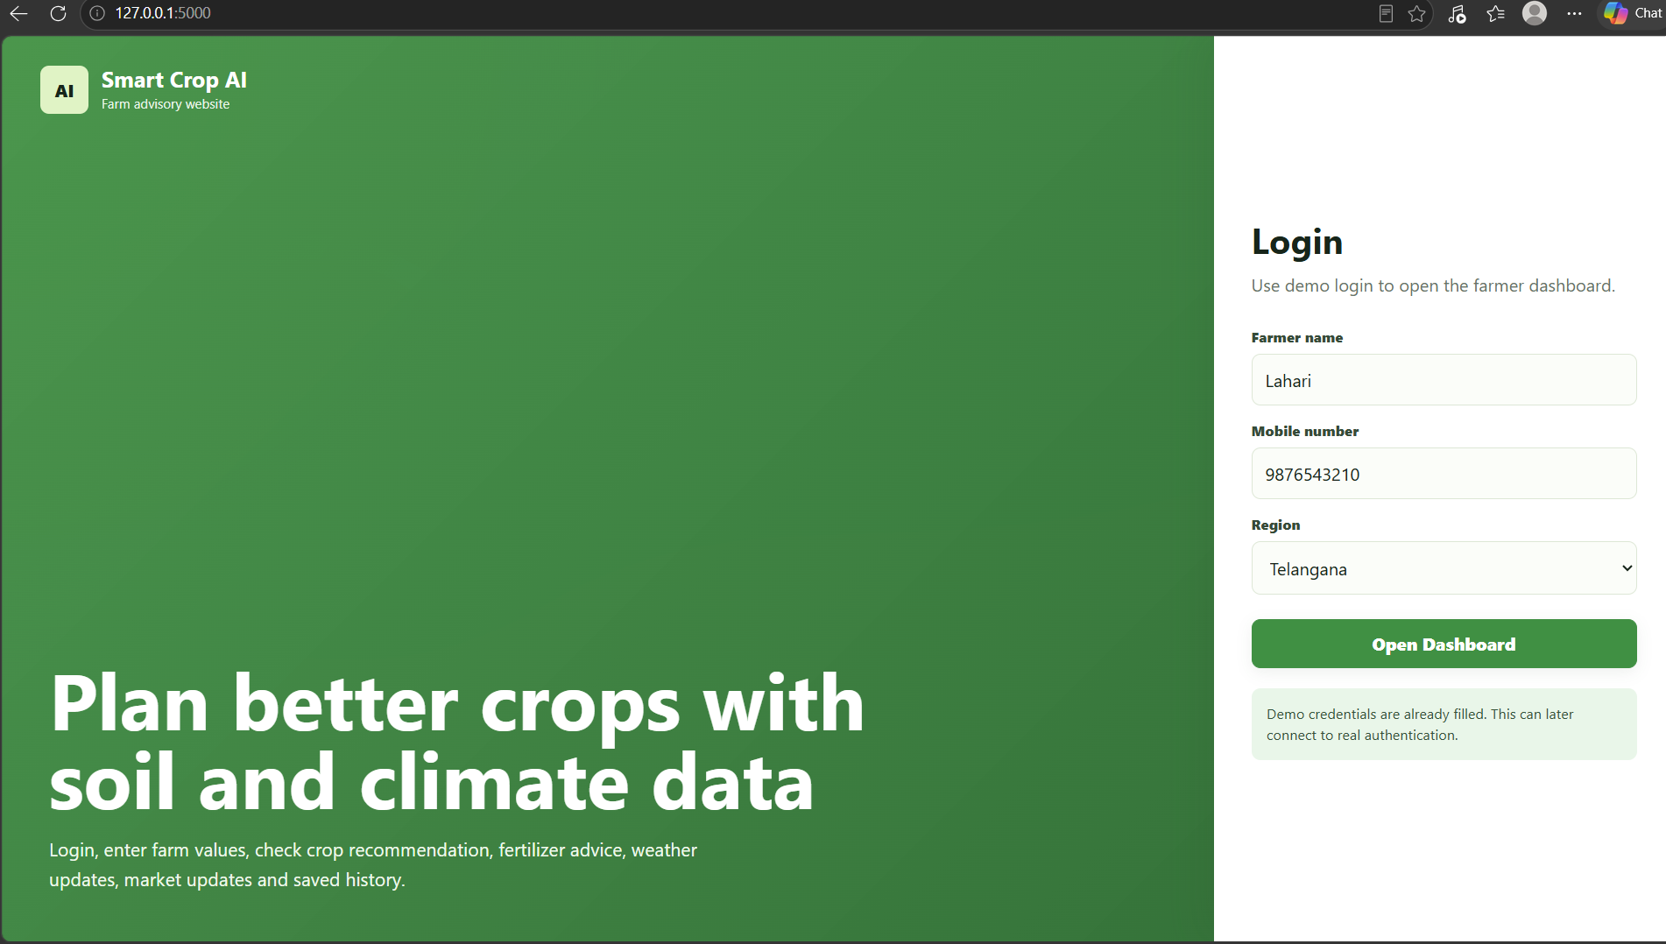
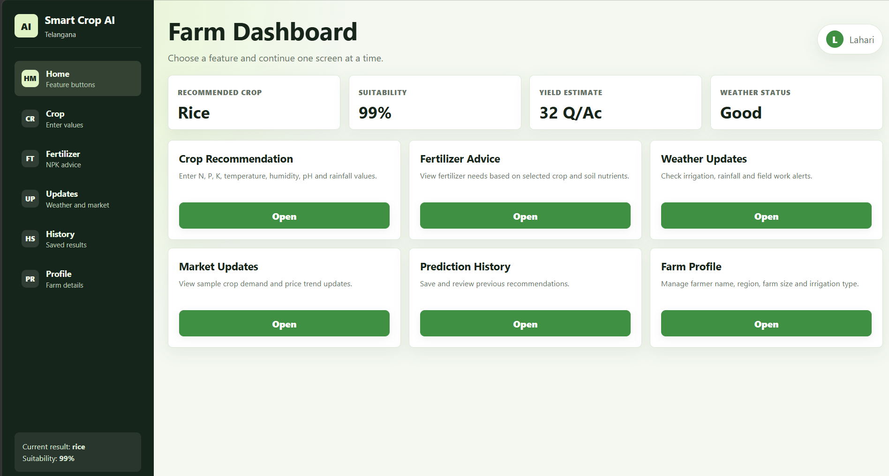
Website Screenshots / Demo
Login Page
Crop Recommendation: 7 soil and climate values in, best crop with top 3 alternatives and reasons out
Farm Dashboard
Notes:
These are screenshots from our running website. On the right, the first screen is the login page, where the farmer enters name, mobile number and region. After login, the farm dashboard shows the current recommended crop, suitability, yield estimate and weather status, with buttons for every feature. The large screenshot is the crop recommendation screen. Here we entered nitrogen 90, phosphorus 42, potassium 43, temperature 20.8, humidity 82, pH 6.5, rainfall 202.9 and land area 2 acres. The system recommends rice, and also shows jute and coffee as the second and third options, along with reasons like rainfall supports rice cultivation.

Slide 17
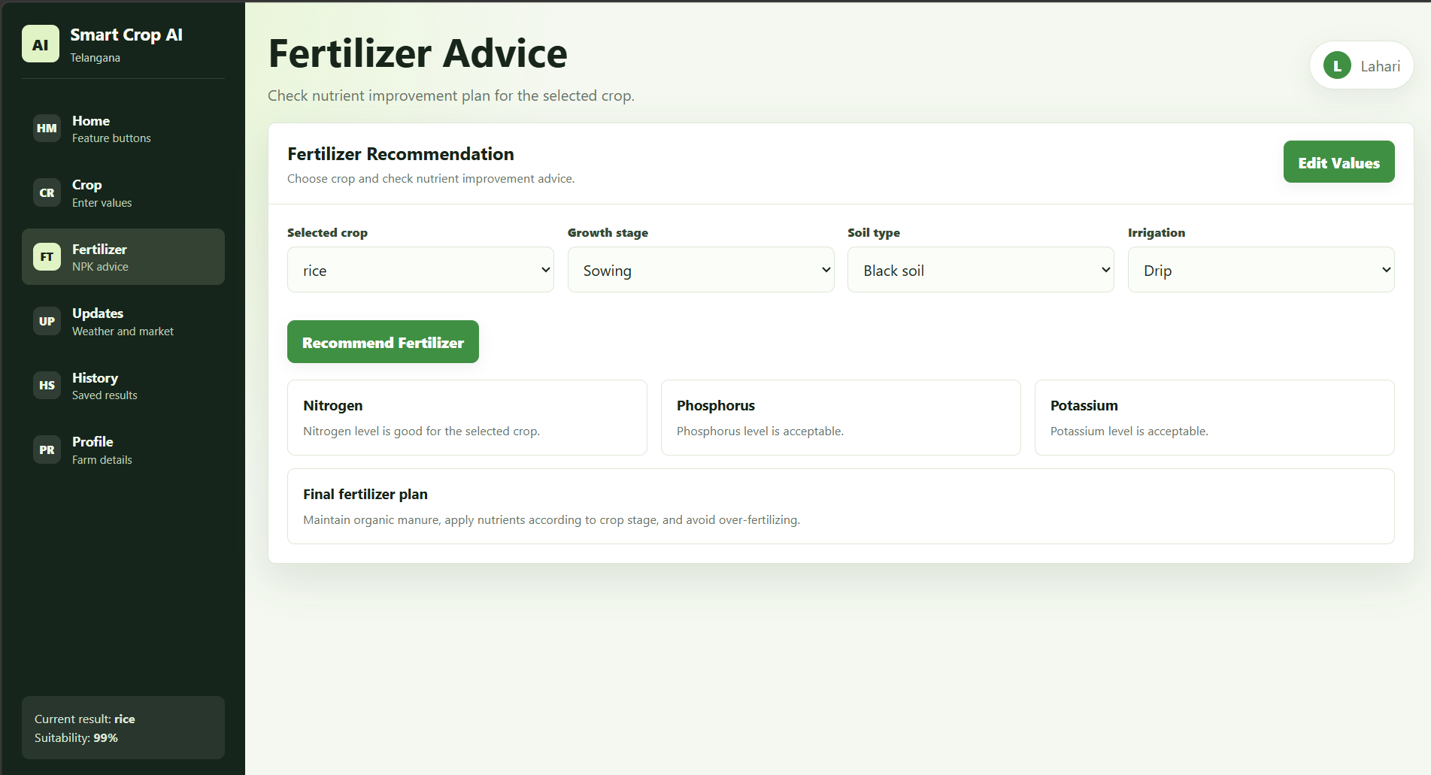
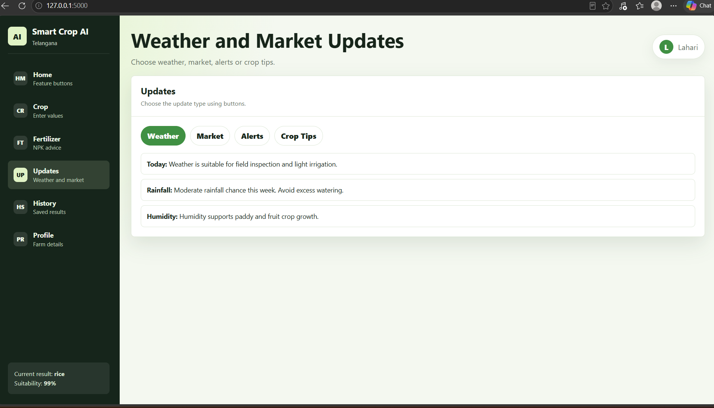
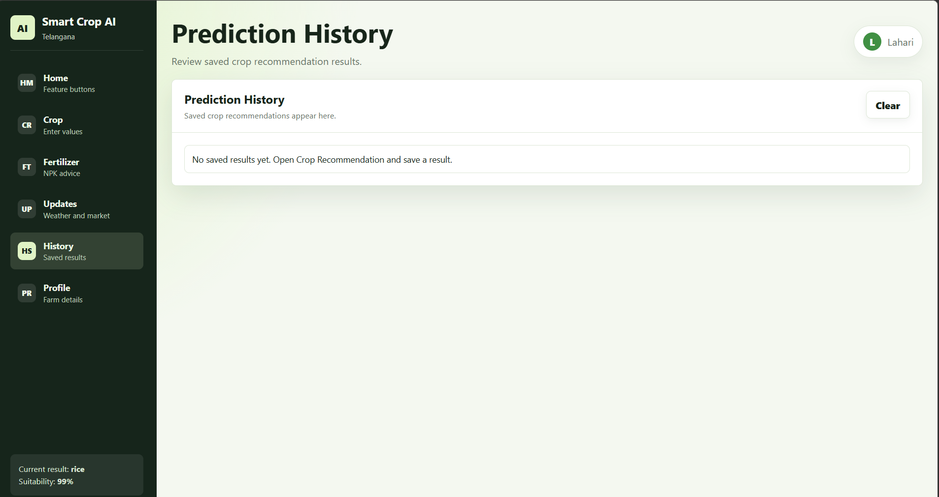
Website Screenshots / Demo (contd.)
Weather & Market Updates
Fertilizer Advice: checks N, P, K against the selected crop and gives a final fertilizer plan
Prediction History
Notes:
This slide shows the remaining screens. The large screenshot is the fertilizer advice screen. The farmer selects the crop, growth stage, soil type and irrigation method, and the system tells whether nitrogen, phosphorus and potassium are good or low, followed by a final fertilizer plan. Here all three nutrients are fine for rice, so it suggests maintaining organic manure and avoiding over-fertilizing. On the right is the updates screen with weather, market, alerts and crop tips tabs; these currently use sample data. Below that is the prediction history screen, where saved recommendations are listed and can be cleared.

Slide 18



Advantages
Fast prediction
Easy UI
Top 3 crops
Fertilizer advice
Farmer dashboard
Instant result from the trained model
Simple form, no technical skill needed
Alternatives with confidence, not just one answer
N-P-K and pH tips reduce overuse
Weather, market, history and profile together
Over the existing system: data-driven, consistent, and available anytime without waiting for an expert
Notes:
These are the main advantages of our system. Prediction is fast because the trained model gives the answer instantly. The interface is simple, so farmers do not need any technical knowledge. Instead of only one crop, we show the top three crops so the farmer has options. Fertilizer advice helps avoid overuse of chemicals. And the dashboard brings weather, market updates, history and profile together in one place. Compared to the existing system, our approach is based on data, gives the same answer for the same input, and is available at any time.

Slide 19






Applications
Farmers
Plan the next season's crop for their land
Agriculture students
Learn how soil and climate affect crops
Agri advisory systems
Who can use Smart Crop AI?
Engine behind advisory centres and helplines
Government farming support
From a single farm to state-level advisory
Pair with soil health card data for guidance
Smart farming apps
Plug in through the REST API
Notes:
Our system can be used in many places. Farmers can use it to plan the next season's crop. Agriculture students can use it to understand how soil and climate affect crop choice. Agri advisory centres and helplines can use it as the engine behind their advice. Government farming programmes can combine it with soil health card data. And because we built a REST API with Flask, any smart farming mobile app can connect to our model.

Slide 20

Limitations
01
02
03
Depends on dataset quality
Needs accurate inputs
Sample-based updates
Trained on one public dataset of 2,200 records; crops outside the 22 classes can't be predicted.
Wrong soil test or weather values lead to wrong recommendations.
Weather and market screens use sample data, not live feeds.
The very high accuracy partly reflects a clean, balanced dataset; real field data will be noisier.
Notes:
Every project has limitations, and ours has three main ones. First, the model depends on the dataset. It was trained on one public dataset of 2,200 records, so it can only recommend those 22 crops. Second, the farmer must enter correct values. If the soil test or rainfall values are wrong, the recommendation will also be wrong. Third, the weather and market update screens currently show sample data, not live information, and the prediction history is kept only while the page is open. We should also be honest that 99.55 percent accuracy is partly because the dataset is very clean and balanced; real field data will be messier.

Slide 21




Future Scope
Phase 1
Phase 2
Phase 3
Phase 4
Phase 5
Live weather API
Market price API
Mobile app
Regional languages
Soil sensors (IoT)
Real-time forecasts, e.g. OpenWeatherMap
Live mandi prices from government open data
Android app for use in the field
Telugu, Hindi, Tamil and voice input
Auto-read N, P, K, pH and moisture
Notes:
In the future, we want to improve the system in five ways. First, connect a live weather API so temperature, humidity and rainfall are filled automatically. Second, connect a real market price API to show live mandi prices. Third, build a mobile app so farmers can use it directly in the field. Fourth, add regional languages like Telugu, Hindi and Tamil, and maybe voice input, so more farmers can use it. Fifth, integrate IoT soil sensors that can read nitrogen, phosphorus, potassium, pH and moisture automatically, so the farmer does not need to type values.

Slide 22
Course Outcome (CO) Mapping
CO | Outcome area | How our project addresses it | Level
CO1 | ML system lifecycle | Full pipeline: CSV → features → training → evaluation → joblib → Flask → UI | 3
CO2 | Linear models | Multinomial Logistic Regression with feature scaling and L2 regularisation | 3
CO3 | Tree-based models | Decision Tree and Random Forest (best); top features: rainfall, humidity, K | 3
CO4 | Unsupervised learning | Not used; future: k-means clustering of soil profiles, PCA plots | –
CO5 | Model evaluation | 80/20 stratified split, accuracy, precision, recall, macro F1, confusion matrix | 2
CO6 | ML engineering & serving | Model packaged with Joblib, served via Flask REST API (POST /api/predict) | 2
Level: 3 = strongly addressed · 2 = partly addressed · – = not addressed
Notes:
This slide maps our project to the six course outcomes. CO1 is about the full machine learning lifecycle, and our project covers it completely: data, features, training, evaluation, saving the model and serving it in a website. CO2 is linear models; we used multinomial logistic regression with feature scaling and regularisation. CO3 is tree-based models; we used a decision tree and a random forest, which was our best model, and its feature importance shows rainfall, humidity and potassium matter most. CO4, unsupervised learning, is not part of this project; in future we could cluster soil profiles using k-means. CO5 is model evaluation; we used a stratified train-test split with accuracy, precision, recall, F1-score and the confusion matrix, so it is partly covered because we did not do cross-validation or hyperparameter search. CO6 is ML engineering; we packaged the model with Joblib and served it through a Flask REST API, but drift monitoring is not added yet, so it is partly covered.

Slide 23

Conclusion
Built an end-to-end ML system: dataset → 5 models → best model → Flask website
99.55%
Random Forest reached 99.55% accuracy on 440 unseen test records
Random Forest accuracy
Farmers get the best crop, top 3 options and fertilizer advice in one dashboard
Thank You
A low-cost, data-driven decision aid for precision agriculture
Questions?
COURSE OUTCOMES
CO1
CO2
CO3
CO5
CO6
Notes:
To conclude, we built a complete machine learning system, from dataset to trained model to a working Flask website. We compared five algorithms, and Random Forest gave the best accuracy of 99.55 percent on unseen test data. Farmers can get the best crop, top three alternatives and fertilizer advice in one simple dashboard. Our overall contribution is a low-cost, data-driven tool that supports precision agriculture. This project also covers our course outcomes: CO1 the full ML lifecycle, CO2 logistic regression, CO3 tree-based models like Random Forest and Decision Tree, CO5 model evaluation with accuracy, precision, recall and F1, and CO6 packaging the model with Joblib and serving it through a REST API. Thank you. We are happy to take any questions.

